Slide 1
How Teachers See Student Wellbeing at School: Developing the SWTRS
Anthony J. Roberson, M.A.
Shelley R. Upton, B.S.
Tyler L. Renshaw, Ph.D., NCSP
Presented Feb. 23, 2017 at the National Association of School Psychologists Annual Convention, San Antonio, TX

Slide 2
Introduction

Slide 3
Youth Mental Health
Promoting MH in youth critical
Links with negative outcomes
Adolescents with depression –>
Later substance dependence¹
Adult depressive episodes²
Externalizing behavior issues –>
Lower academic achievement³
MH among the most costly health care expenses in U.S.⁴

Slide 4
The Public Health Model
Connecting at-risk youth to MH services a priority
Curb negative outcomes as early as possible⁵
School is de facto MH care provider for youth⁶
Should focus on developing these systems⁷
Teacher/parent referral model common but problematic⁷
Population MH prevention/intervention may be superior alternative…
Notes:
Preventative pub health model
Public health drum beat: “An ounce of prevention is worth a pound of cure”

Slide 5
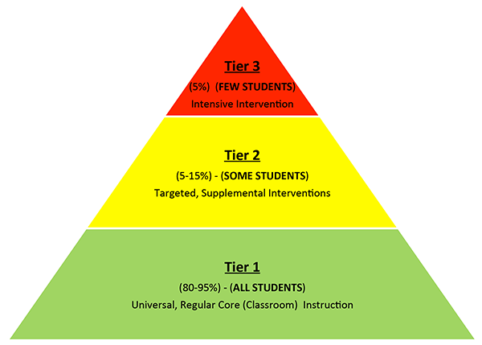
Universal MH Screening
MH screening of entire school populations gaining traction
Advantages^{8,9}:
Systematic way of identifying at-risk youth
Helps identify students who would otherwise be missed
Calculate norms for local (within schools) and distal comparisons (between schools)
Individual- and group-level comparisons possible
Helps parse individual vs. systemic problems
Can link with MTSS¹⁰

Slide 6
WB and Dual-factor MH
Increased focus on WB
Change from focus on presence or absence of PTH
Evidence for value of both PTH and (S)WB
Related but distinct constructs varying along two dimensions
Dual-factor MH (DFMH)
Two-continua
Bi-dimensional
DFMH useful in assessing youth risk
Greenspoon & Saklofske (2001)¹¹
Suldo et al. (2008; 2011)^{12, 13}

Slide 7
Developing a New Screener for Youth WB: SWTRS
More study on WB screening needed
Some current youth WB screeners:
Positive Experiences At School Scale (PEASS)¹⁴
Student Subjective Wellbeing Questionnaire (SSWQ)¹⁵
Self-report
School-specific
Multidimensional
Brief
SWTRS aims to fill a gap...
Teacher-report WB screener for K-5th grade
Potentially assess students too young to self-report
Increases feasibility of administration
Different underlying WB theory than past scales...
Notes:
PEASS: elementary self-report
SSWQ: adolescent self-report

Slide 8

SWTRS Theory of WB
Exploratory extension of “Feeling good” and “Functioning well” (FG/FW) model of WB
Validation evidence has only come from self-report¹⁶
Using broader definition of FG/FW to test its worth with teacher-report
Focus on observable classes of behavior
“Excitement” is acceptable as there are commonly recognized public behaviors that indicate its presence
“Life satisfaction” not acceptable as it requires much higher level of inference
Broadly aligns with traditional psychodiagnostic view of MH¹⁷
Depression
Notes:
DSM depression:
Relatively persistent depressed mood
Impairment in adaptive daily functioning

Slide 9
Hypotheses
Two latent factors comprise WB screener item pool: “feeling good” and “functioning well”
Factors would show technical adequacy
Small to moderate correlations with PTH measures
WB items strong predictors of concurrent school outcomes
WB + PTH better predictor than PTH alone

Slide 10
Method

Slide 11
Participants: Teachers
Charter Elementary School Grades K–5
Two teachers per grade-level
Teachers (N = 12)
Median age = 28 (23–65)
83.3% female
Median years teaching = 4 (1–25)
50% held masters degree; 50% bachelors
6 White; 3 Black/Af. Am.; 1 Multiracial; 2 Not reporting

Slide 12
Student Demographics
Students rated by their teacher (N = 184)
Median age = 8 (5–13)
56% female
181 Black/Af. Am.; 1 each Am. Ind., Pacific Islander, Multiracial
Median number of students rated per teacher = 16.5 (7–21)

Slide 13
Measures: SWTRS
Initial item pool of positive student behaviors aligned with FG/FW
Developed, refined, and derived scales used for predictive analyses
54 items in original item pool
Teacher-rated student behavior frequency from previous two months:
0 = Almost Never to 3 = Almost Always
Ultimately reduced to 17 items total and three (!!!) subscales
More on this later…

Slide 14
Measures: SIBS/SEBS
Student Internalizing/Externalizing Behavior Scale
Teacher-report measures of student PTH
7 items per scale
SIBS: e.g., “clings to adults,” “withdrawn”
Clinical risk threshold score: 8
Omega = .85 [.79, .88], se = 0.022
SEBS: e.g., “gets angry easily,” “disrupts class activities”
Clinical risk threshold score: 9
Omega = .93 [.90, .94], se = .009
Frequency ratings: 0 = Never to 3 = Frequently/almost always

Slide 15
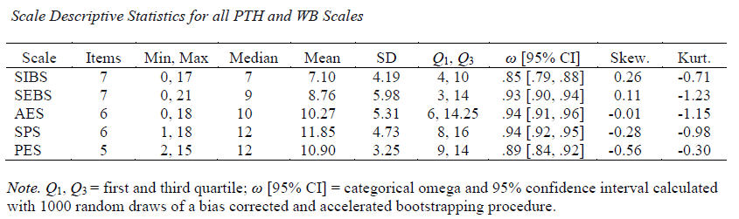
SIBS/SEBS Descriptives
NOTE: At clinical risk threshold!

Slide 16
Concurrent School Outcomes
Academic achievement in math and ELA
“In the past two months, how well has the student performed in English Language Arts/Math?”
1 = Far below grade level to 5 = Far above grade level
School absences
“In the past two months, about how many full days of school has the student missed?”
Open numeric response
Time on-task
“In the past two months, about what percent of time was the student on-task during class?”
1 = 0–10% to 10 = 90–100%

Slide 17
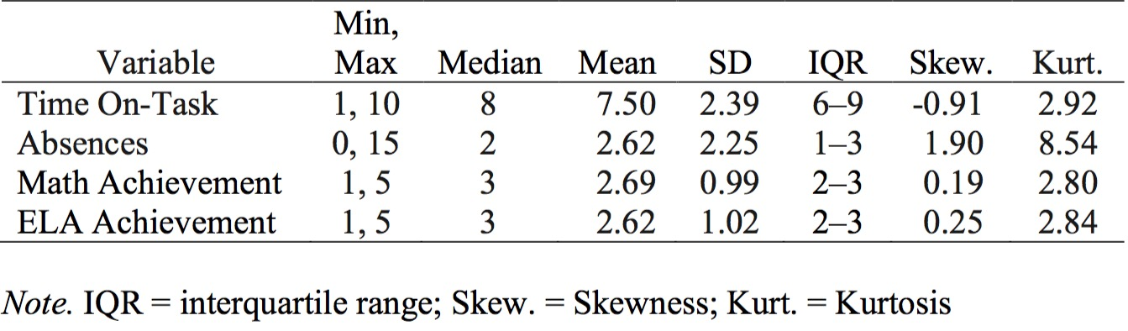
Concurrent Outcome Variable Descriptives
Better treated as count data vs. continuous
Non-normal

Slide 18
Item Pool Creation Procedure
Items aligned with hypothesized FG/FW behavioral indicators
Tailored specifically for school environment
Items also had to measure incompatible behaviors from SIBS/SEBS
2–4 incompatible behavior items drafted for each of the 14 SIBS/SEBS items
Initial 54-item pool

Slide 19
Expert Review
Five content experts reviewed the items
Definitions:
“Feeling Good: Teacher’s perception that a student experiences positive emotions or affective states”
“Functioning Well: Teacher’s perception that student behavior is consistent with academic and social success at school.”
Item rating domains:
Construct association
“feeling good,” “functioning well,” “both,” or “neither”
Sureness
“not very sure,” “pretty sure,” or “very sure”
Relevance
“low relevance,” “mostly relevant,” or “highly relevant”

Slide 20
Expert Review cont.
Narrative feedback optional
Items removed from pool if...
At least 3 of the 5 experts were “pretty sure” or “very sure” that
The item related to ”both” or ”neither” construct or
The item had “low relevance” to the selected construct
Reduced and revised item pool contained 36 items

Slide 21


Data Collection
Informed consent received
Data gathered in secure online database
Random teacher/student letter assignment A–L
Most (n = 144) data gathered during one-hour professional development block at the school
Remainder (n = 40) by the end of week
Gift card raffle at the end

Slide 22
Preliminary Analyses
Data “tidying”
Visual and statistical summaries of variables and models
No significant outliers
No missing student data
Assumptions checked

Slide 23
SWTRS Latent Structure
Exploratory Factor Analysis
Goals:
Identify latent factor structure
2 factors posited
Reduce item pool
Factor extraction method
Principal axis factoring
Factor rotation method
Direct oblimin
~NERD TIP 1~ Use polychoric correlation matrix over standard Pearson correlation matrix when factor analyzing ordinal data!
Notes:
Relatively small sample

Slide 24
SWTRS Latent Structure cont.
Evaluate pattern matrix
Items considered for removal if:
Factor loading < .30
Cross factor loading > .30
Communality < .50
Item loads in theoretically inconsistent way

Slide 25
SWTRS Scales Descriptive Statistics
Final number of items
Scale median, mean, and SD
Minimum and maximum score
Interquartile range
Skewness and kurtosis
Average inter-item correlation
Internal consistency: categorical omega [95% CI]
~NERD TIP 2~ Using omega plus confidence interval over Cronbach’s alpha with ordinal data makes you a very cool and impressive scientist

Slide 26
SWTRS Construct Validity
Measures of association:
Zero-order and semi-partial correlation r
Factor correlation phi
Beta coefficients
Predicted association directionality
SWTRS v. SIBS/SEBS: Negative
SWTRS v. academic achievement and time on-task: Positive
SWTRS v. number of absences: Negative

Slide 27
SWTRS Concurrent and Incremental Validity
Math, ELA, and Time On-Task predicted with hierarchical regression
Absences predicted with generalized linear modeling
~NERD TIP 3~ Modeling over-dispersed count data on a negative binomial distribution with log link function and robust covariance estimates will also make you a very cool and impressive scientist
Four models evaluated for each outcome:
PTH alone
WB alone
PTH + WB
Reduced model with only significant predictors

Slide 28
Results

Slide 29
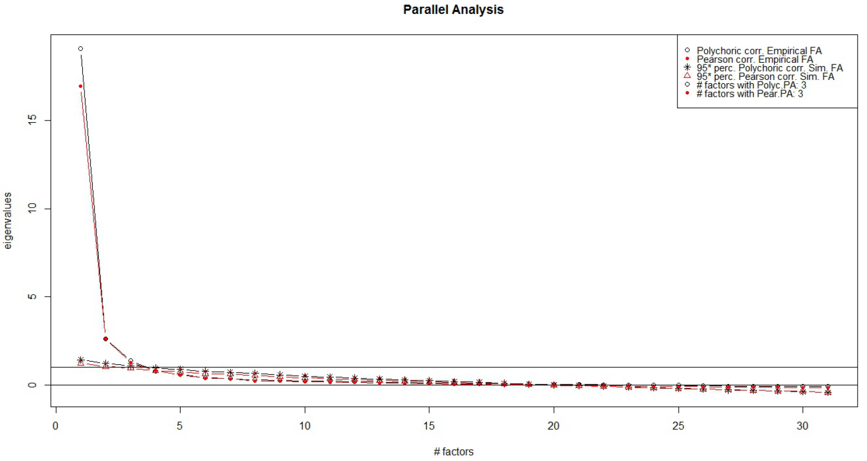
SWTRS Latent Structure
EFA 1:
31 SWTRS items
18 removed after expert feedback
5 removed after testing for excessive multicollinearity among the items predicted to factor together
Three-factor solution
Factors were not FG/FW! ☹
Total explained variance = 68.8%
Factor interpretation:
Academic Engagement Scale (AES)
12 items, λ >= .602
Student Prosociality Scale (SPS)
14 items, λ >= .643
Positive Emotionality Scale (PES)
5 items, λ >= .458

Slide 30
SWTRS Latent Structure cont.
Additional EFAs attempted with weak functioning or conceptually redundant items removed
Tested if possible to shape factor structure to better align with FG/FW
EFA 2:
Retained strongest 25 items that fit FG/FW
Three-factor solution of AES, SPS, and PES...again
Total explained variance = 73.2%

Slide 31
SWTRS Latent Structure cont.
FG/FW was clearly not tenable for these data
Nonetheless, engagement and prosocial behavior important WB indicators so retained for remainder of analyses
Final EFA aimed to simplify the scales
EFA 3:
17 strongest items from previous model
Total variance explained = 73.3%
Factor correlations: φ range = .63 – .76

Slide 32
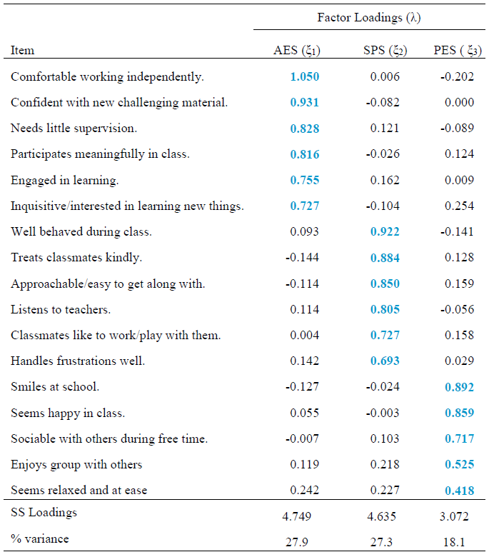
EFA Pattern Matrix for Final Three-Factor SWTRS Measurement Model
AES
SPS
PES

Slide 34
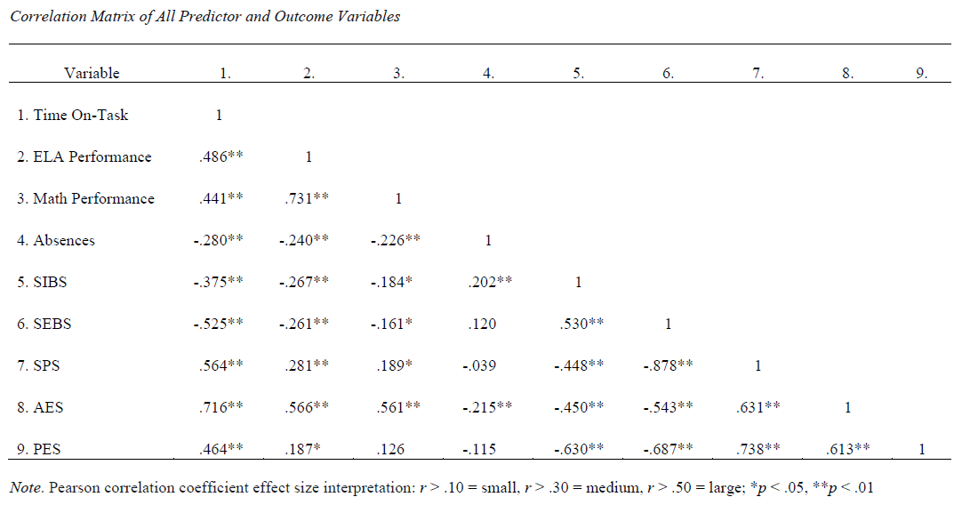
SWTRS Construct Validity

Slide 35
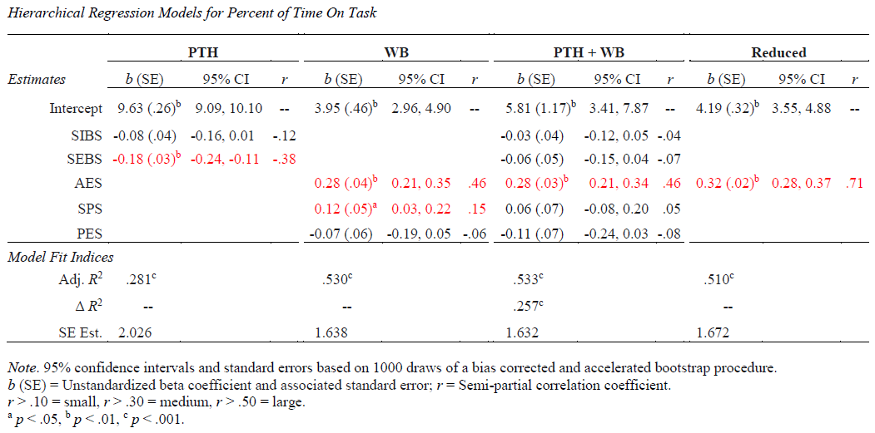

Time On-Task

Slide 36
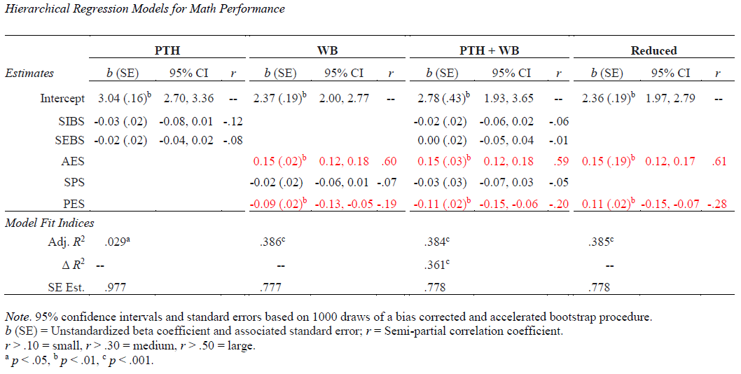
Math Performance

Slide 37
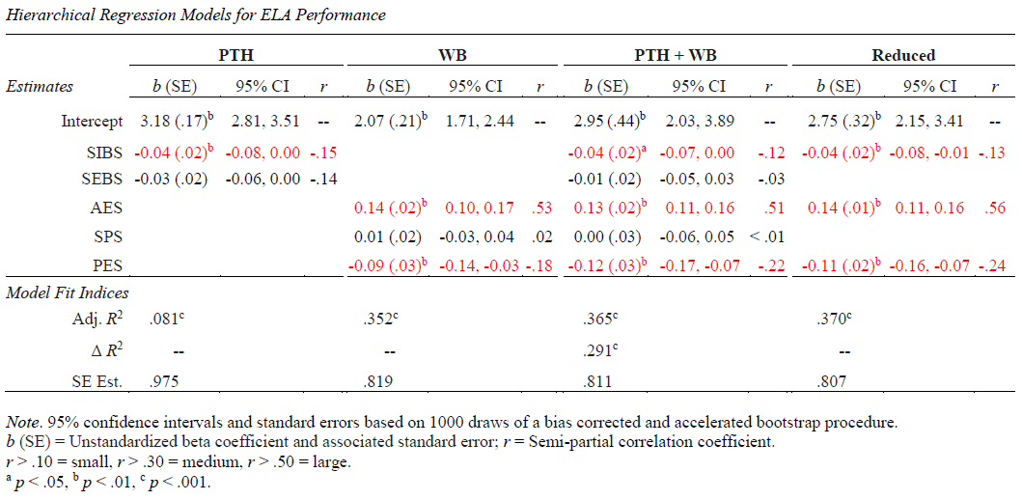
ELA Performance

Slide 38
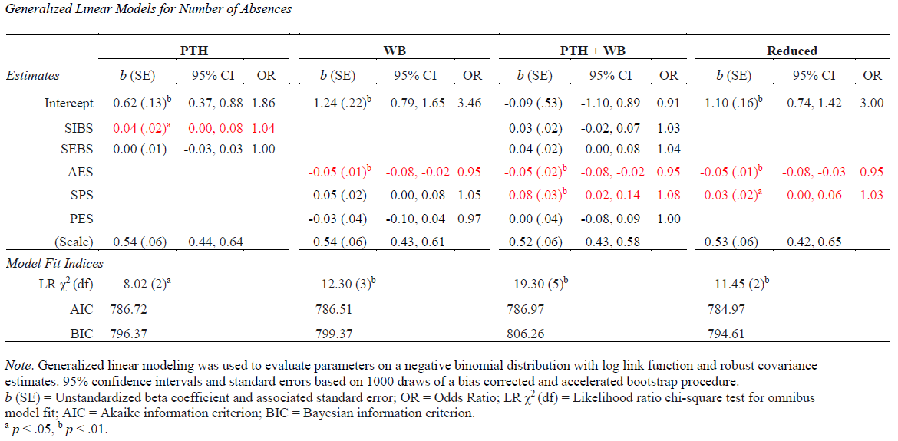
Absences

Slide 39
Discussion

Slide 40
Goals
Two broad goals for study
Develop brief teacher-report student WB scales grounded in extension of FG/FW theory
Historically supported with self-report evidence
Examine SWTRS validity
Association with counterpart PTH scores
Association with concurrent school outcomes

Slide 41
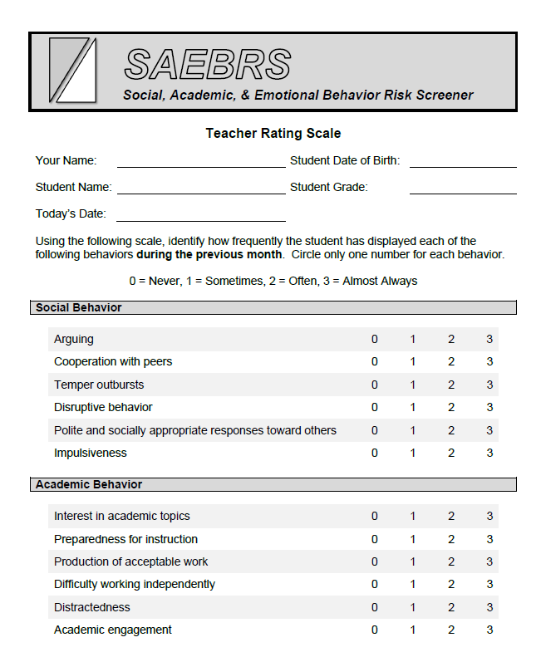
Structural Validity
EFA conclusions:
FG/FW model failed to generalize to present data as hypothesized
Three non-hypothesized but meaningful WB indicator scales emerged (AES, SPS, PES)
SWTRS similar to SAEBRS^{18,19}
Developed from alternative theory of “academic enablers”
Designed to predict academic risk rather than broader MH risk
Uses positive and negative behaviors in same scale
SAEBRS and SWTRS distinct enough for different screening goals
Notes:
FG/FW = cross context state of being
SWTRS = context specific MH
SAEBRS resulting scales are similar adding some support for findings but distinct

Slide 42
Structural Validity cont.
SWTRS scales measure broad context-specific meta-constructs
AES
Tripartite model of engagement found among the items²⁰
Affective
Behavioral
Cognitive
Used in past DFMH studies as outcomes²¹
SPS
Contains elements of an (overlapping) five-factor model of social skills^{22, 23}
Peer relations
Self-management
Compliance
Academic behaviors (more similar to AES)
Assertion
PES
Inconclusive
Need to reevaluate item content
Notes:
AES: Disagreement about how to measure the construct, tripartite has best support
Use found in previous dual-factor MH studies
(Lyons, Huebner, & Hills, 2012) used these as outcomes (All self-report)
Behavioral Engagement subscale of School Engagement Scale (Fredricks et al., 2005)
(Cog) Future goals and Aspirations subscale of Student Engagement Instrument
(Emo) School Satisfaction subscale on Multidimensional Student Life Satisfaction Scale
SPS:
Assesses 3 of the 5 social skills domains
Caldarella & Merrell (1997) meta
Warnes, Sheridan, Geske, & Warnes (2005) teacher, student, parent qualitative

Slide 43
Structural Validity cont.
WB v. PTH variable correlations high-medium, low-large magnitude
Except for SPS v. SEBS
Generally consistent with past dual-factor studies²⁴
SPS essentially inverse of SEBS
Cf. SAEBRS Social Behavior v. SSIS-SS²⁵
Notes:
Earhart et al., 2009 had similar correlation magnitude for SWB variables
SWB (Hope, life-satisfaction, school connectedness) v. PTH (student and teacher report BESS scores)
SPS/SEBS essentially inverse backed by
SAEBRS evidence (von der Embse et al., 2015)
Theory (Caldarella & Merrell, 1997)

Slide 44
Concurrent Validity
The WB only models (included only AES, SPS, and PES):
Best overall model for predicting math performance
AES and PES significant individual predictors
2nd best model for Time On-Task, ELA, and absences
All reduced models included SWTRS scales
Sig. but small estimate for SIBS in ELA
Similar conclusions and relation magnitude to past research^{13, 21, 26}
Notes:
Improvement over null similar to Kim et al., 2014
Similar associations compared to past research
Lyons et al., 2012
Suldo et al., 2011

Slide 45
Incremental Validity
PTH block significant for all outcomes
All magnitudes small/trivial except SEBS in Time On-Task (small)
Adding WB block significantly improved fit for all but absences
WB model showed better fit than the PTH block for absences
Adding PTH after WB never contributed significantly
Notes:
Considering PTH and WB together when predicting absences dampens magnitude of WB predictors

Slide 46
Limitations
Exploratory study with relatively small sample size
Little student demographic diversity
No omnibus MH scale outcome data studied
Outcomes estimated exclusively from teacher-report
Estimates vs. objective measures
Common method bias

Slide 47
Future Directions
Replication and extension with larger, more diverse sample
More objective outcome measures
e.g., report card grades, attendance records, ODRs, DBRs
Omnibus MH/behavioral health rating scales
CFA/SEM analysis approach
Longitudinal predictive validity
Further exploration and development of PES content
Comparisons with SAEBRS
Stay tuned for dissertation...

Slide 48
Conclusions
Some initial empirical support found for the SWTRS
Predicted important school-related outcomes
Incremental validity over SIBS/SEBS
AES particularly strong predictor
Some dual-factor evidence found but...
Stronger evidence in favor of positive behavior/WB focus rather than both PTH and WB

Slide 49
References
Marmorstein, N. R., Iacono, W. G., & Malone, S. M. (2010). Longitudinal associations between depression and substance dependence from adolescence through early adulthood. Drug and Alcohol Dependence, 107, 154-160. doi:10.1016/j.drugalcdep.2009.10.002
Rudolph, K. D., & Klein, D. N. (2009). Exploring depressive personality traits in youth: Origins, correlates, and developmental consequences. Development and Psychopathology, 21, 1155-1180. doi: 10.1017/S0954579409990095
Bradshaw, C. P., Buckley, J. A., & Ialongo, N. S. (2008). School-based service utilization among urban children with early onset educational and mental health problems: The squeaky wheel phenomenon. School Psychology Quarterly, 23, 169-186. doi: 10.1037/1045-3830.23.2.169
Keyes, C. L. M. (2007). Promoting and protecting mental health as flourishing: A complementary strategy for improving national mental health. American Psychologist, 62, 95–108. doi: 10.1080/17439760902844228
Lane, K. L., Oakes, W., & Menzies, H. (2010). Systematic screenings to prevent the development of learning and behavior problems: Considerations for practitioners, researchers, and policy makers. Journal of Disability Policy Studies, 21, 160–172. doi: 10.1177/1044207310379123
Burns, B. J., Costello, E. J., Angold, A., Tweed, D., Stangl, D., Farmer, E. M., & Erkanli, A. (1995). Children's mental health service use across service sectors. Health Affairs, 14, 147-159. doi: 10.1377/hlthaff.14.3.147
Strein, W., Hoagwood, K., & Cohn, A. (2003). School psychology: A public health perspective I. Prevention, populations, and systems change. Journal of School Psychology, 41, 23-38. doi: 10.1016/S0022-4405(02)00142-5
Albers, C. A., & Kettler, R. J. (2014). Best practices in universal screening. In P. Harrison & A. Thomas (Eds.), Best practices in school psychology: Data-based and collaborative decision making. Bethesda, MD: The National Association of School Psychologists.
Dowdy, E., Ritchey, K., & Kamphaus, R. W. (2010). School-Based Screening: A Population-Based Approach to Inform and Monitor Children’s Mental Health Needs. School Mental Health, 2, 166-176. doi: 10.1007/s12310-010-9036-3
Stoiber, K. C. (2014). A comprehensive framework for multitiered systems of support in school psychology. In P. Harrison & A. Thomas (Eds.), Best practices in school psychology: Data-based and collaborative decision making. Bethesda, MD: The National Association of School Psychologists.
Greenspoon, P. J. & Saklofske, D. H. (2001). Toward an integration of subjective wellbeing and psychopathology. Social Indicators Research, 54, 81–108. doi: 10.1023/A:1007219227883
Suldo, S. M. & Shaffer, E. J. (2008). Looking beyond psychopathology: The dual-factor model of mental health in youth. School Psychology Review, 37, 52–68. Retrieved from: https://www.researchgate.net/publication/228656864
Suldo, S., Thalji, A., & Ferron, J. (2011). Longitudinal academic outcomes predicted by early adolescents’ subjective wellbeing, psychopathology, and mental health status yielded from a dual factor model. The Journal of Positive Psychology, 6, 17–30. doi:10.1080/17439760.2010.536774

Slide 50
References
Furlong, M. J., You, S., Renshaw, T. L., O’Malley, M. D., & Rebelez, J. (2013). Preliminary development of the Positive Experiences at School Scale for elementary school children. Child Indicators Research, 6, 753–775. doi: 10.1007/s12187-013-9193-7
Renshaw, T. L., Long, A. C. J., & Cook, C. R. (2014). Assessing adolescents’ positive psychological functioning at school: Development and validation of the Student Subjective Wellbeing Questionnaire. School Psychology Quarterly. Advance online publication. doi: 10.1037/spq0000088
Keyes, C. L. M. (2006). Mental health in adolescence: Is America’s youth flourishing? American Journal of Orthopsychiatry, 76, 395-402. doi: 10.1037/0002-9432.76.3.395
American Psychiatric Association. (2013). Major Depressive Disorder. In Diagnostic and statistical manual of mental disorders (5th ed.; pp. 160–168). Arlington, VA: American Psychiatric Publishing.
Kilgus, S. P., Chafouleas, S. M., & Riley-Tillman, T. C. (2013). Development and initial validation of the Social and Academic Behavior Risk Screener for elementary grades. School Psychology Quarterly, 28, 210–226. doi:10.1037/spq0000024
Kilgus, S. P., Eklund, K., von der Embse, N. P., Taylor, C. N., & Sims, W. A. (2016). Psychometric defensibility of the Social, Academic, and Emotional Behavior Risk Screener (SAEBRS) Teacher Rating Scale and multiple gating procedure within elementary and middle school samples. Journal of School Psychology, 58, 21–39. doi:10.1016/j.jsp.2016.07.001
Jimerson, S. R., Campos, E., & Greif, J. L. (2003). Toward an understanding of definitions and measures of school engagement and related terms. California School Psychologist, 8, 7– 27.
Lyons, M. D., Huebner, E. S., & Hills, K. J. (2012). The dual-factor model of mental health: A short-term longitudinal study of school-related outcomes. Social Indicators Research, 114, 549–565. doi:10.1007/s11205-012-0161-2
Caldarella, P., & Merrell, K. W. (1997). Common dimensions of social skills of children and adolescents: A taxonomy of positive behaviors. School Psychology Review, 26, 264–278.
Warnes, E. D., Sheridan, S. M., Geske, J., & Warnes, W. A. (2005). A contextual approach to the assessment of social skills: Identifying meaningful behaviors for social competence. Psychology in the Schools, 42, 173–187. doi:10.1002/pits.20052
Earhart Jr., J., Jimerson, S. R., Eklund, K., Hart, S. R., Jones, C. N., Dowdy, E., & Renshaw, T. L. (2009). Examining relationships between measures of positive behaviors and negative functioning for elementary school children. The California School Psychologist, 14, 97– 104.
von der Embse, N. P., Pendergast, L. L., Kilgus, S. P., & Eklund, K. R. (2015). Evaluating the applied use of a mental health screener: Structural validity of the Social, Academic, and Emotional Behavior Risk Screener. Psychological Assessment. Advance online publication. doi:10.1037/pas0000253
Kim, E. K., Furlong, M. J., Dowdy, E., & Felix, E. D., (2014). Exploring the relative contributions of the strength and distress components of dual-factor complete mental health screening. Canadian Journal of School Psychology. Advance online publication. doi:10.1177/0829573514529567

Slide 51
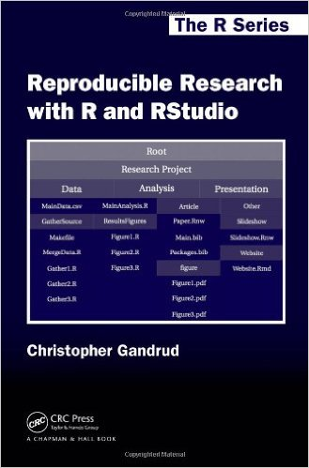
Thank You!
Interested in collaborating?
Email: tonyjroberson@gmail.com
All data, analysis code, and research report documentation is freely available at github.com/TonyRoberson/Thesis
~NERD TIP 4~ Participate in open science!
R/RStudio
Github
Authoria

